Slide 1
Module P11
Practical: Introduction to authentication, hashing, curl & sessions

Slide 2
Contents
Objective:
Implement a password storage system
Password hashing
Why salt?
Implement a login system
API based
User creation
Implement a session system
Cookie based
Testing our APIs/endpoints using curl

Slide 3
Tasks ahead
Implement a basic hash function that is good to use for passwords
Implement a create user API endpoint
Implement a login API check endpoint
Implement a login html page that uses the API
Once logged in, create a session
On logout, delete a session
Create a logged-in page

Slide 4
Demo

Slide 5
Todo
Add a registration page
Check if the user is logged in
If the user is not logged in, show login/registration form
If the user is logged in, show a welcome ‘user’ section
If the user is logged in, show a logout button on the header
Add a comments section to all the article pages
If the user is logged in, allow the user to submit comments

Slide 6
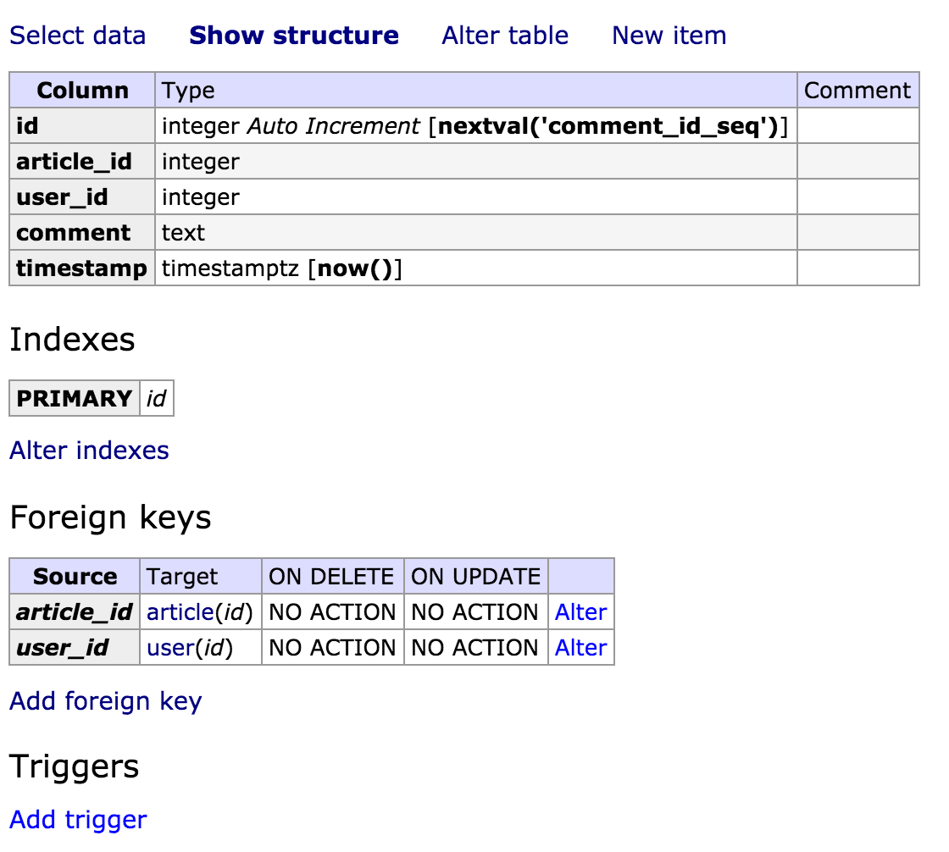
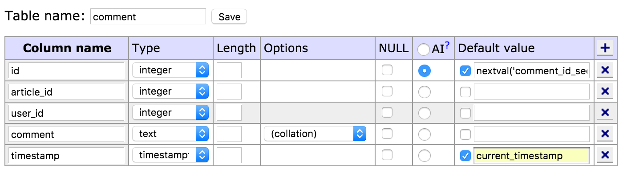
Final result
Demo of all basic features working together
Check out source code at:
https://github.com/coco98/imad-2016-app
Check out SQL schema if required at:
Github - coco98 - schema.sql
Images below as reference to create comments table

Slide 7
Very Important things to remember!
This entire exercise is educational!
Don’t try to implement password hashing completely manually
In a production app try to use libraries like passport.js to make life easy and to make sure that your implementation is secure.

